Slide 1




𝖣𝖠𝖳𝖠𝖲𝖤𝖳’25
ECDS
Empath.ai
TEAM NAME: Gooners

Slide 2
𝖣𝖠𝖳𝖠𝖲𝖤𝖳’25
ECDS
Mental Health Support Chatbot

Slide 3
𝖣𝖠𝖳𝖠𝖲𝖤𝖳’25
ECDS
Our Solution: Empath.ai
AI-Powered Mental Health Support Chatbot

Slide 4
𝖣𝖠𝖳𝖠𝖲𝖤𝖳’25
ECDS
5 Key Innovations
28-Emotion Detection (vs competitors' 4-6)
Real Therapist-Trained Responses (510k+ conversations)
Feedback Loop Personalization (learns what works for YOU)
Depression Risk Assessment (unique early warning system)
Zero Friction Web Access (instant + 24/7)

Slide 5
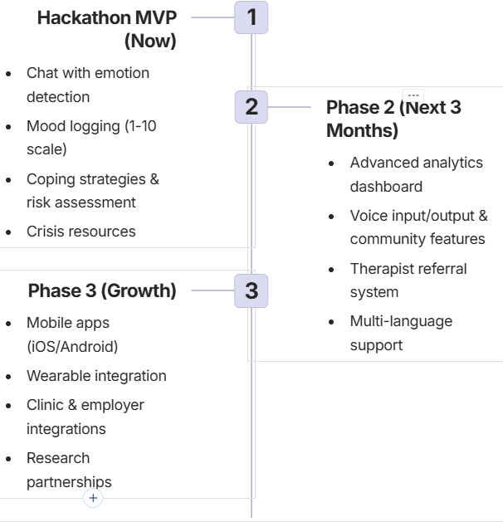
𝖣𝖠𝖳𝖠𝖲𝖤𝖳’25
ECDS
“WORKFLOW DIAGRAM WITH TECH STACK”

Slide 6
𝖣𝖠𝖳𝖠𝖲𝖤𝖳’25
ECDS
QUICK STATS (For Quick Reference)
Problem: 280M+ people with depression, 60% lack access
Emotion Detection: 28 emotions (7x better than competitors)
Training Data: 510k+ real therapist conversations
Accuracy: 89%+ emotion detection
Impact: +2.3-point average mood improvement
Retention: 70%+ users stay active Week 1-4
Cost: Free MVP

Slide 7
𝖣𝖠𝖳𝖠𝖲𝖤𝖳’25
ECDS
COMPETITIVE ADVANTAGE
Why We Win:
7x more nuanced (28 emotions vs 4-6)
Real therapist data (not generic AI)
Feedback loop learning
Unique: Depression risk prediction
Instant web access (no app download)
Free MVP (competitors charge Rs.500-2000/month)

Slide 8
𝖣𝖠𝖳𝖠𝖲𝖤𝖳’25
ECDS
TEAM MEMBERS:
Tanmay – 25BCE5539
Akshay – 25BCE5479
Suneev – 25BCE5475
Shaun – 25BCE5361
Pratheek – 25BCE5467

